Slide 1
ElectroMania
Road Accidents Prediction
Team Details: Mayur Gupta: 8791216171 Mansi Garg: 9057567304

Slide 2
Description of the Project
Problem Statement
Approach to the Solution
To create an interactive traffic accident predictor that would be easily accessible by anyone.
To create an accident predictor, we decided to train our model using data science.
Relevance to the Theme
Techstack Involved
Our model solves the real world problem of increasing number of road accidents by predicting the probability of their occurance.
Python’s scikit-learn library was used for model training and evaluation. We attempted classification model of random forest which measures accuracy

Slide 3
Details of Technology Stack
openweathermap.org API provided the current weather conditions.
ipdata.co API provided the details of current location
API
Computing the relation between severity of accidents and the weather conditions
Data Visualization
Trained the collected data to predict appropriate results.
ML

Slide 4
Description of the Solution
Step 1
Step 2
Searched the past records
Planned to solve the problem of rising number of accidents
2021
Step 3
Step 4
Engaged in our work and discovered techniques to solve the problem
Created a working model using those techniques

Slide 5
Novelty of the Solution
A weather-related accident is defined as one that occurs in any adverse condition such as sleet, snow, rain, fog, winds or on slick pavement. The number of accidents is rising exponentially day by day. And one of the biggest reasons for the same is harsh weather conditions. So there is much need for such a technology which helps us avoiding such mishappenings.

Slide 6
Growth Plan of the Product
(You can modify percentage according to your requirement)
10%
Collected the required data from past records.
Checkpoint 1
25%
Understanding the features due to which accidents may take place.
Checkpoint 2
50%
Trained the data using supervised learning(Classification)
Checkpoint 3
75%
Used current weather and location API as input in our model
Checkpoint 4

Slide 7
Business Aspects of the Hack
01
Market Impact
Automobile companies got a new feature to be added for their new productions
Target Consumers
02
The automobile companies can use our model.
03
Financial Sustainability
Our model requires no hardware but software for installation in the digital gadget.
Product > Project
04
Our model needs to be installed in the vehichles with digital gadgets. And we are ready to use the model.

Slide 8
Social Impact
Traffic accidents are extremely common. If you live in a sprawling metropolis like I do, chances are that you’ve heard about, witnessed, or even involved in one. Because of their frequency, traffic accidents are a major cause of death globally, cutting short millions of lives per year. Therefore, a system that can predict the occurrence of traffic accidents or accident-prone areas can potentially save lives.

Slide 9
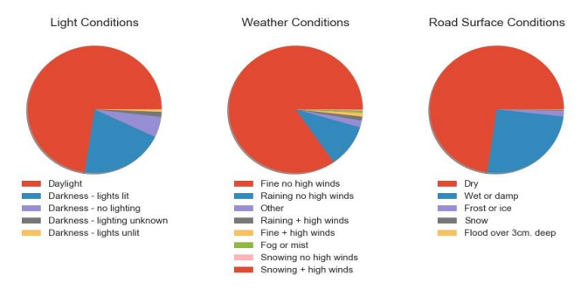
Working Prototype
Accidents affecting measures:

Slide 10
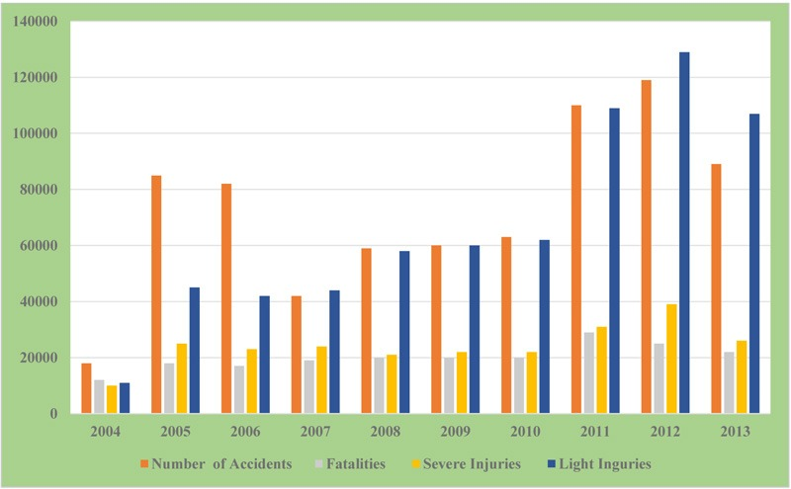
Working Prototype

Slide 11
Learning Curve
What have you learnt by doing this project?
04
01
Growth 1
We have analysed the real-world problem and the records amazed us!
This made us think of its solution.
03
02
Growth 2
02
Then we stepped forward and learnt Data Science, which is the best tool for it.
01
03
Growth 3
We have learnt training our model and predicting the results, not so perfect, but yes good enough to keep motivated.
04
Growth 4
Then we worked on our model more and then came to learn many more techniques, which made our model near to perfect.

Slide 12
About Team
01
02
Mayur Gupta
Mansi Garg
API and Dataset Visualization
Data Viualization and Training Data
03
04
Member 3
Member 4
Image and Role
Image and Role

